Slide 1
Guided Selling for Sales Cloud
Yogesh Motwani, Riya Thosar
January, 2018
[Internal]

Slide 2
Disclaimer
Details to be decided This Document might fail to provide details regarding the behavior of some controls. Those will be worked out in development. For questions, please contact C4C UX.
Content is for illustration purposes only Content will be determined by product management during definition;
Not visual design This document describes the form and behavior at a mid level and does not account for the visual design;
Cloud for Customer specific This document presents the configuration needed specific to C4C and does not include requirements for other applications.

Slide 3
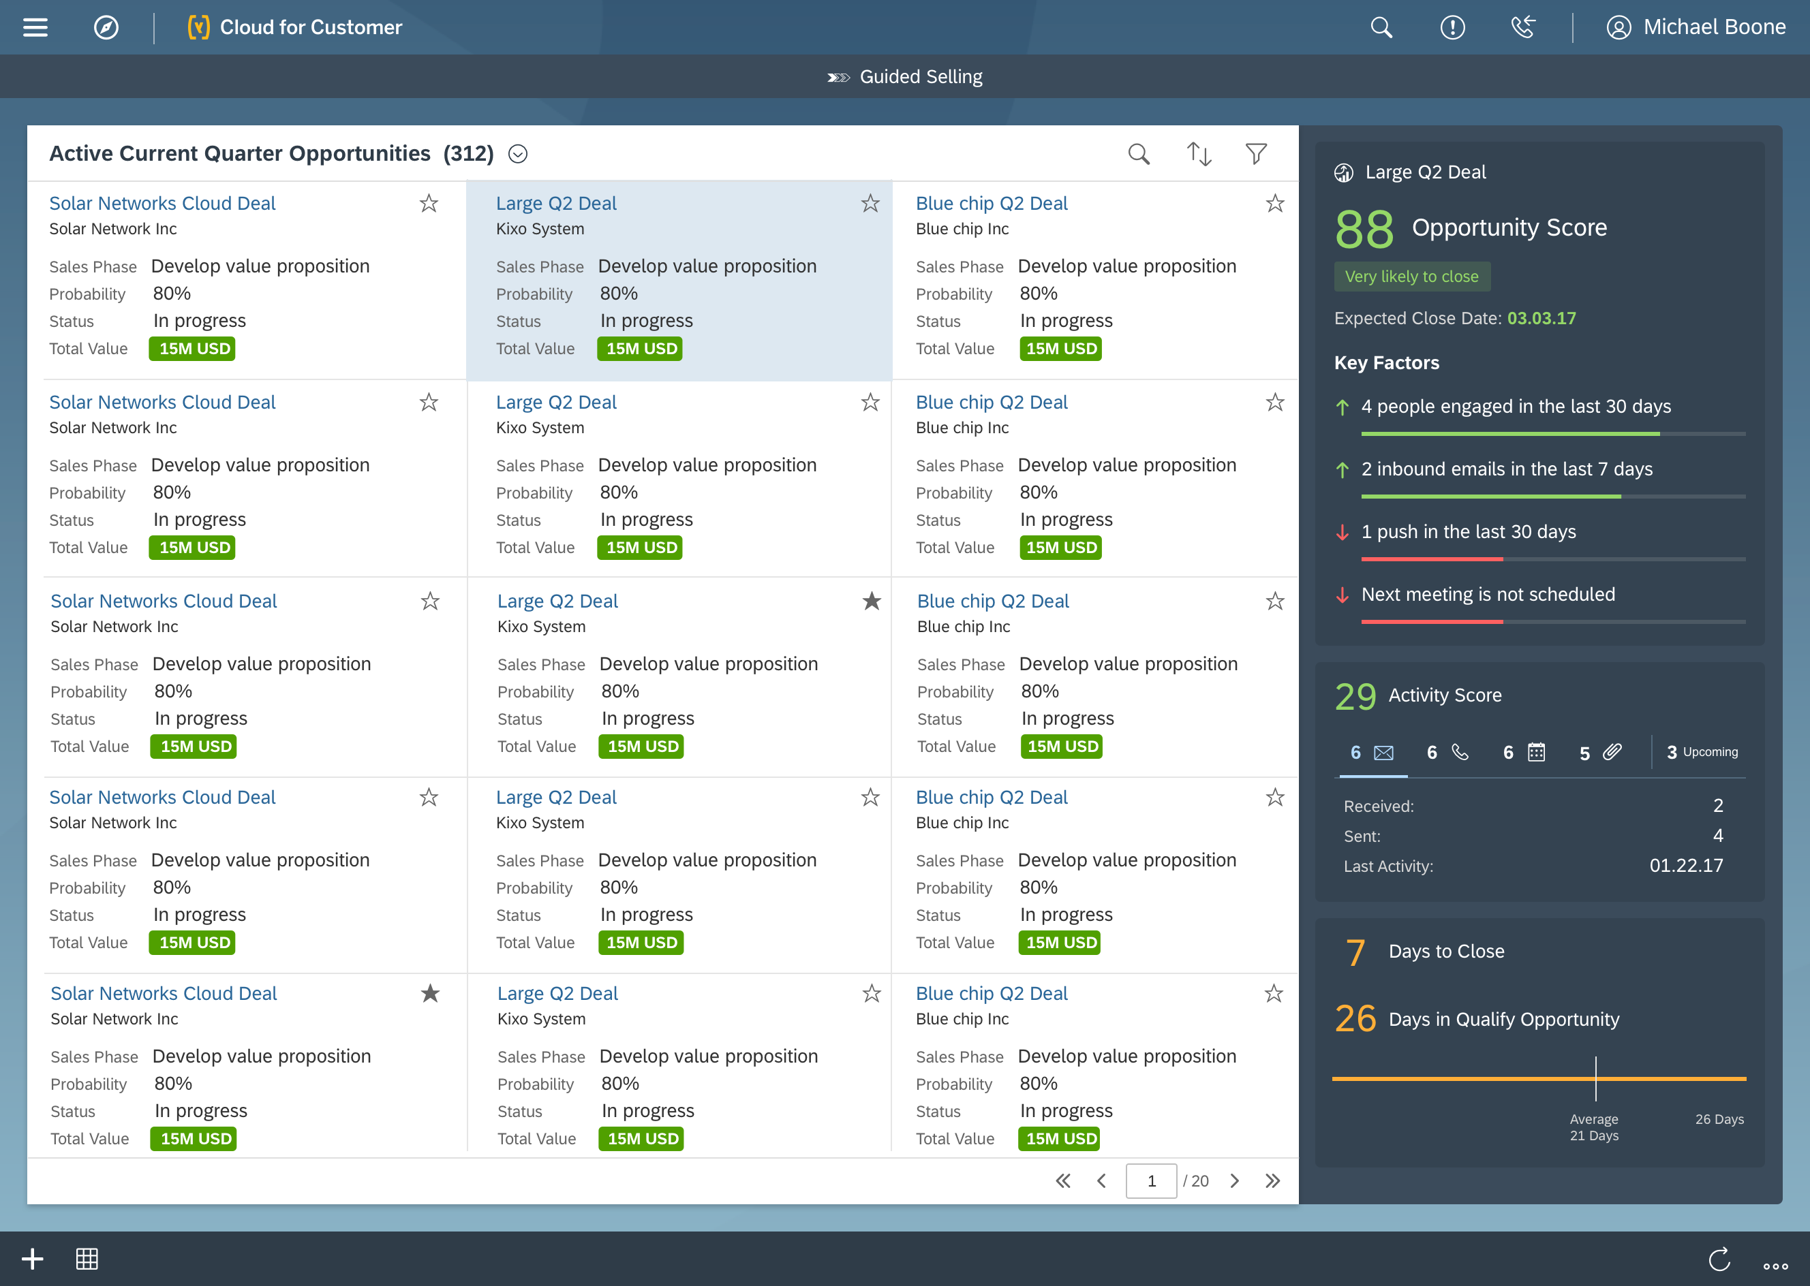
Opportunity List

Desktop

Slide 4
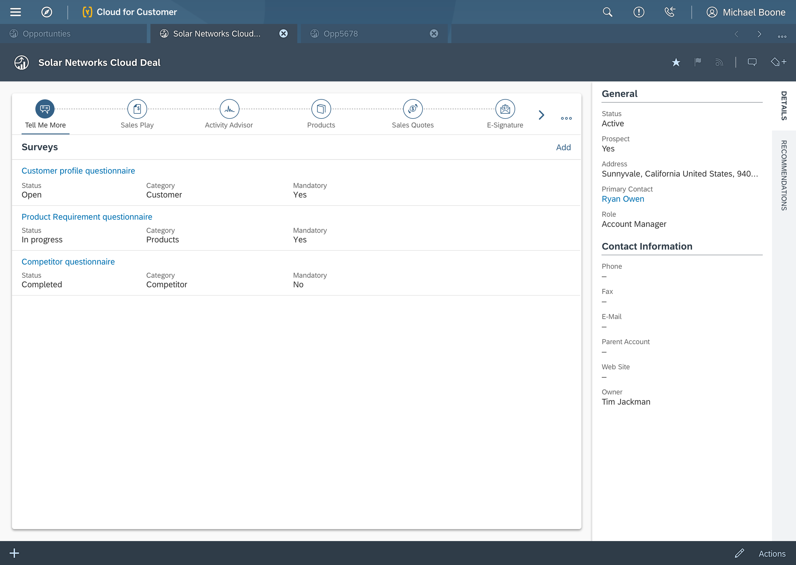
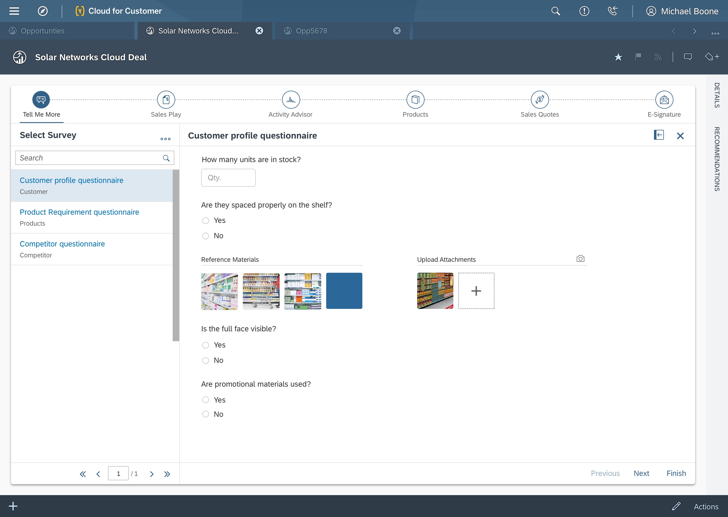
Survey Object
In Guided Selling

Desktop

Slide 5
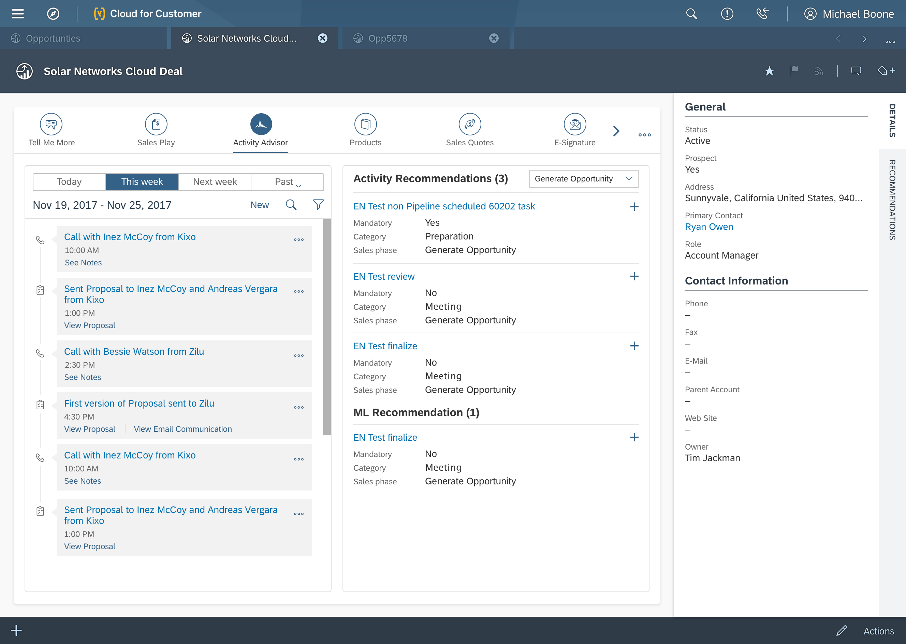
Sales Activity with recommendation for all stages
In Guided Selling

Desktop

Slide 6
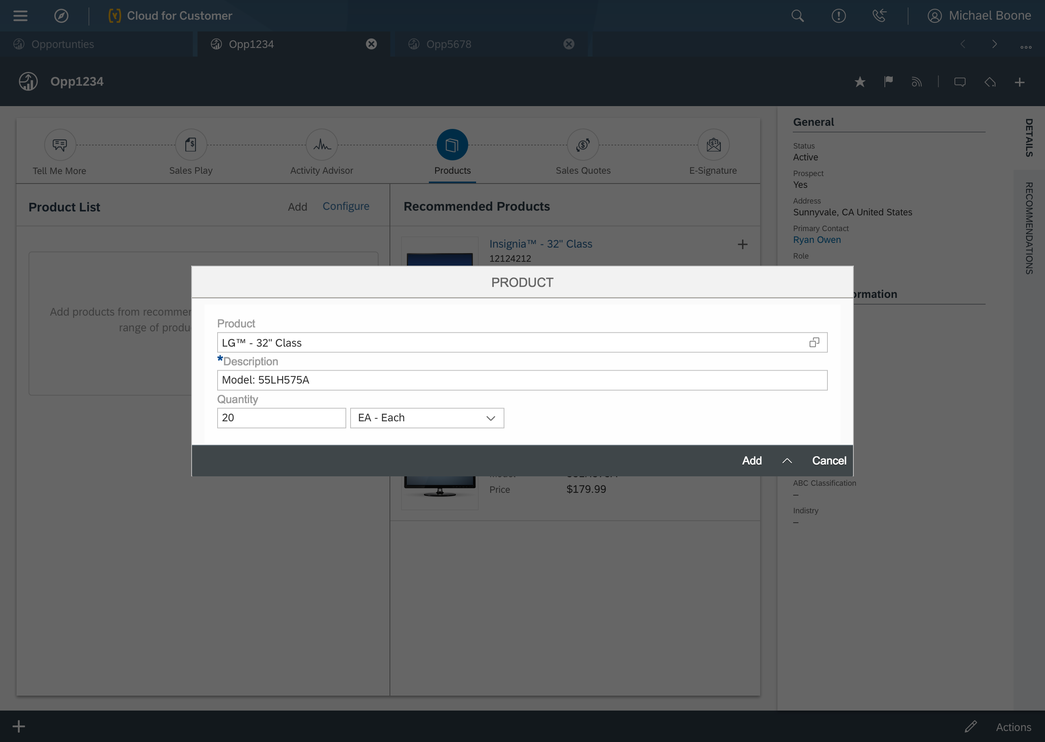
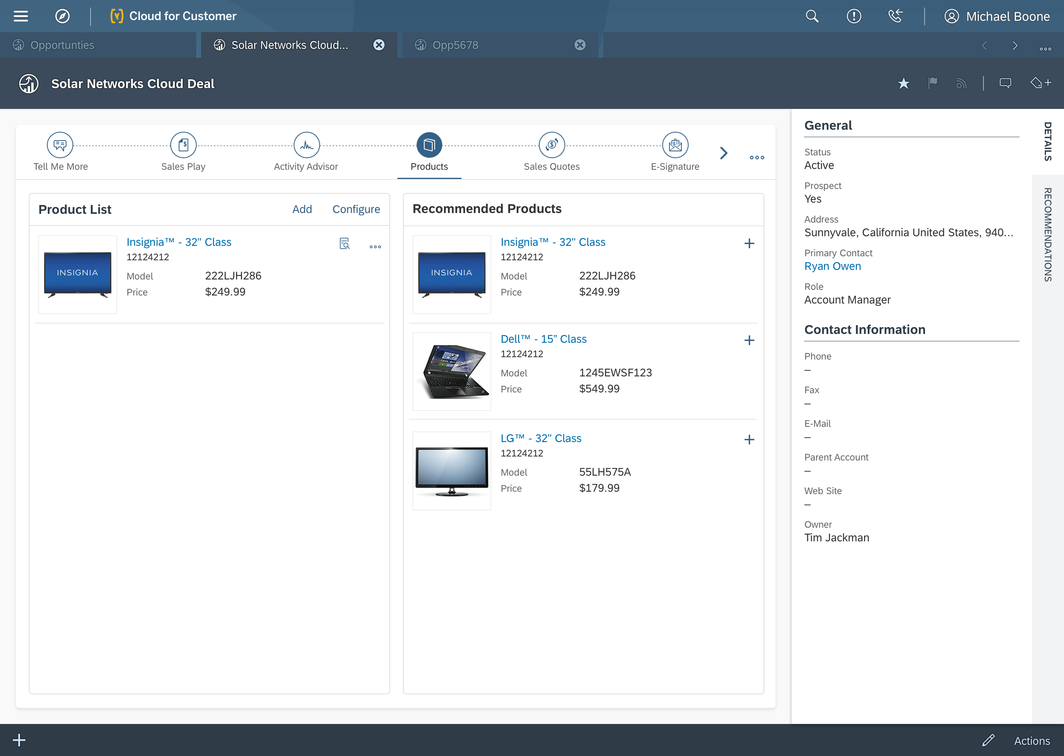
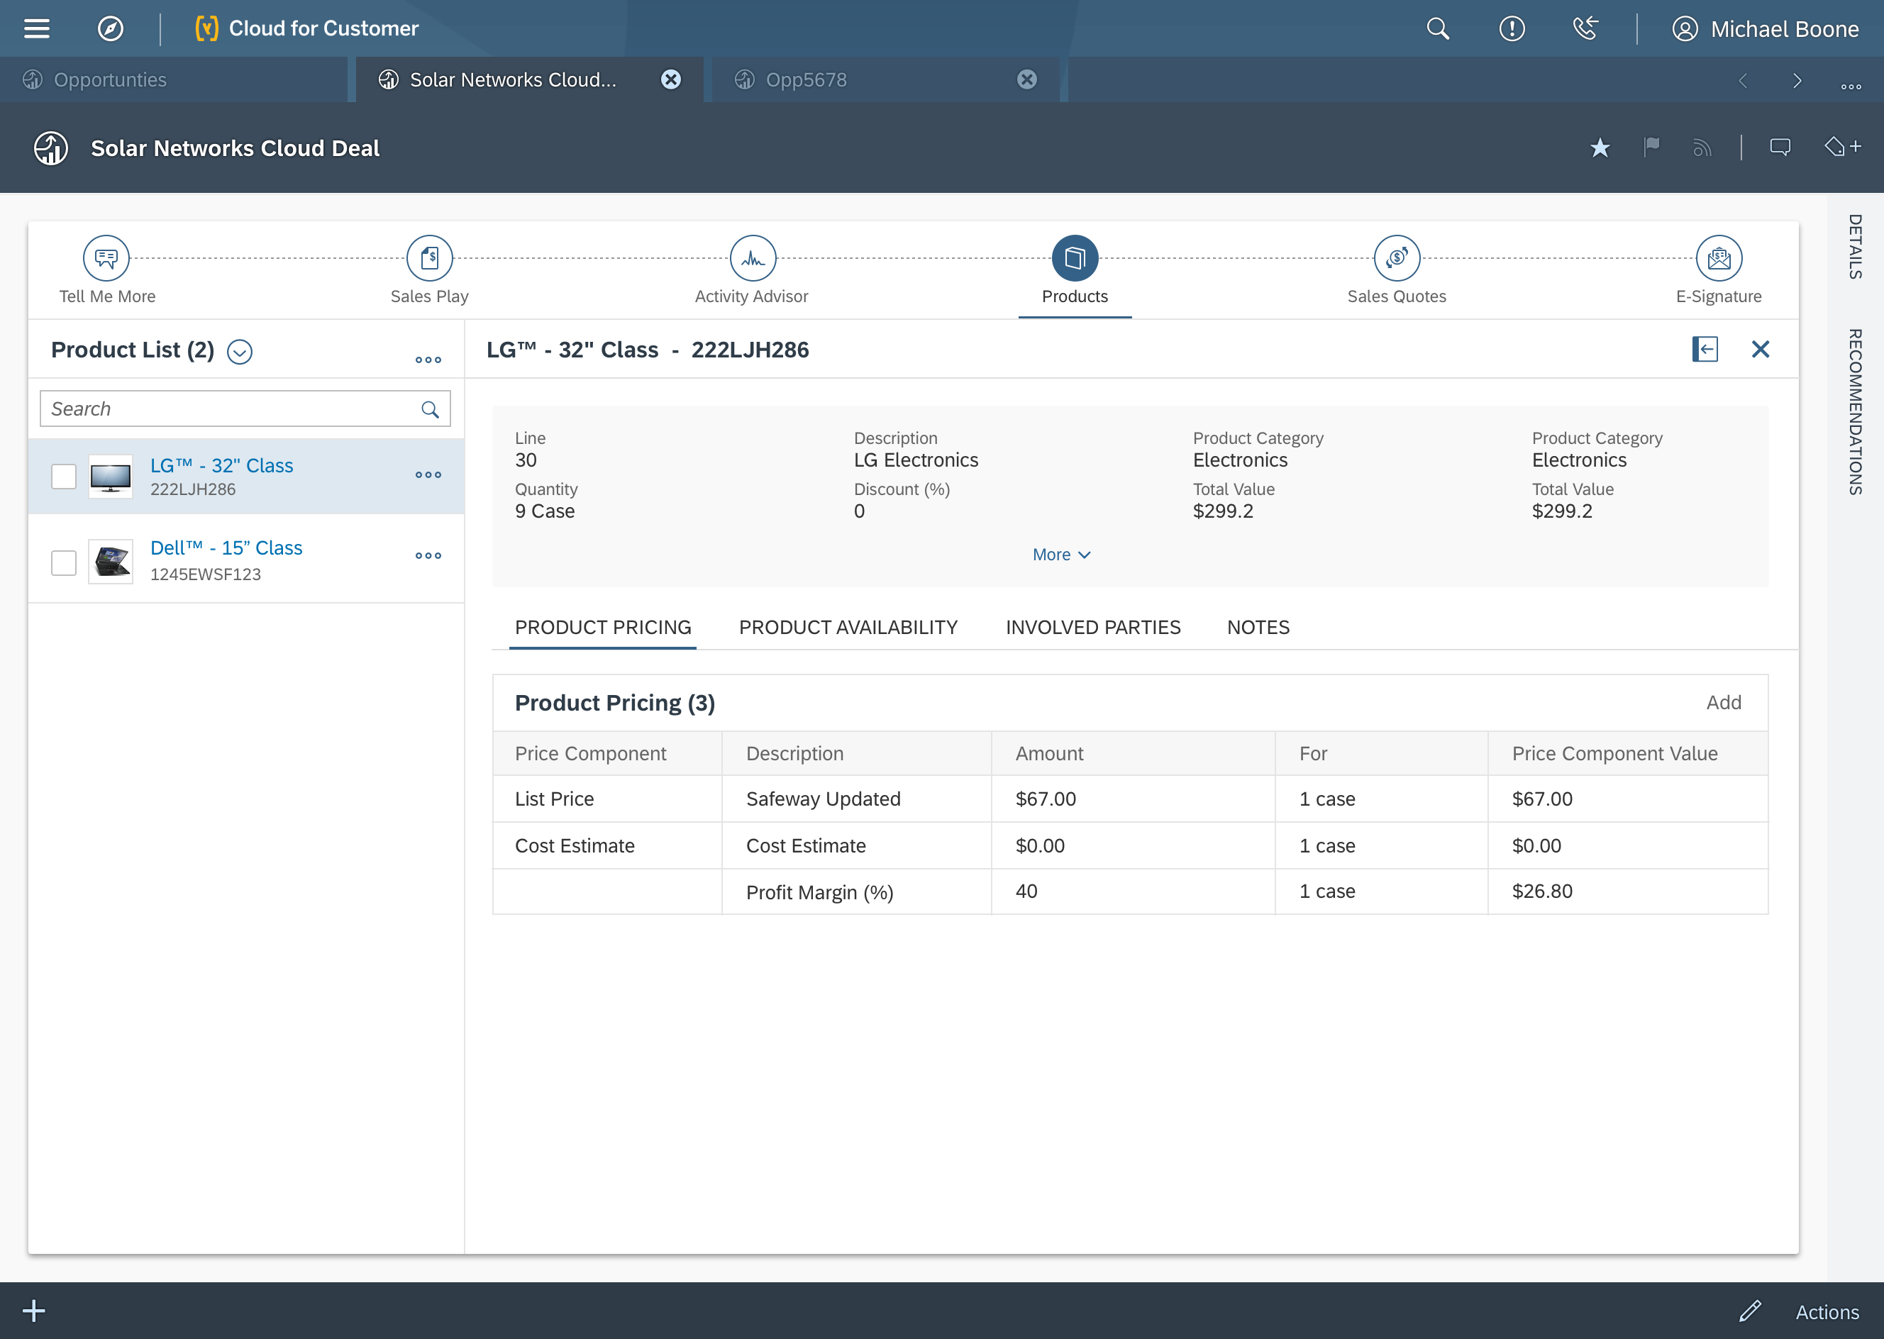
Product Object with recommendations
In Guided Selling

Desktop

Slide 7
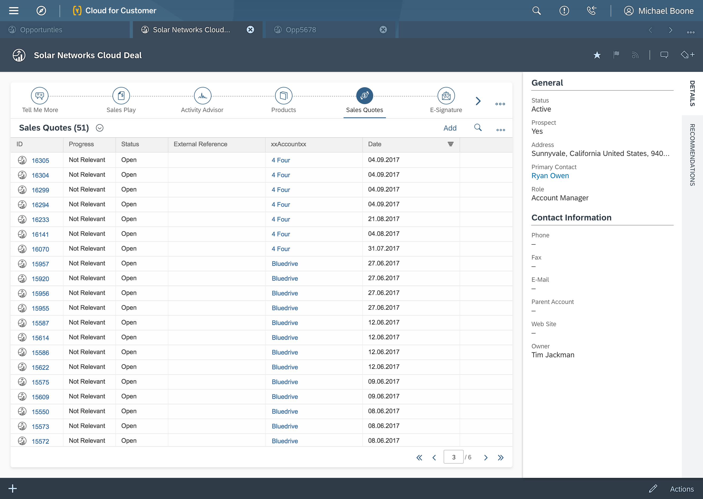
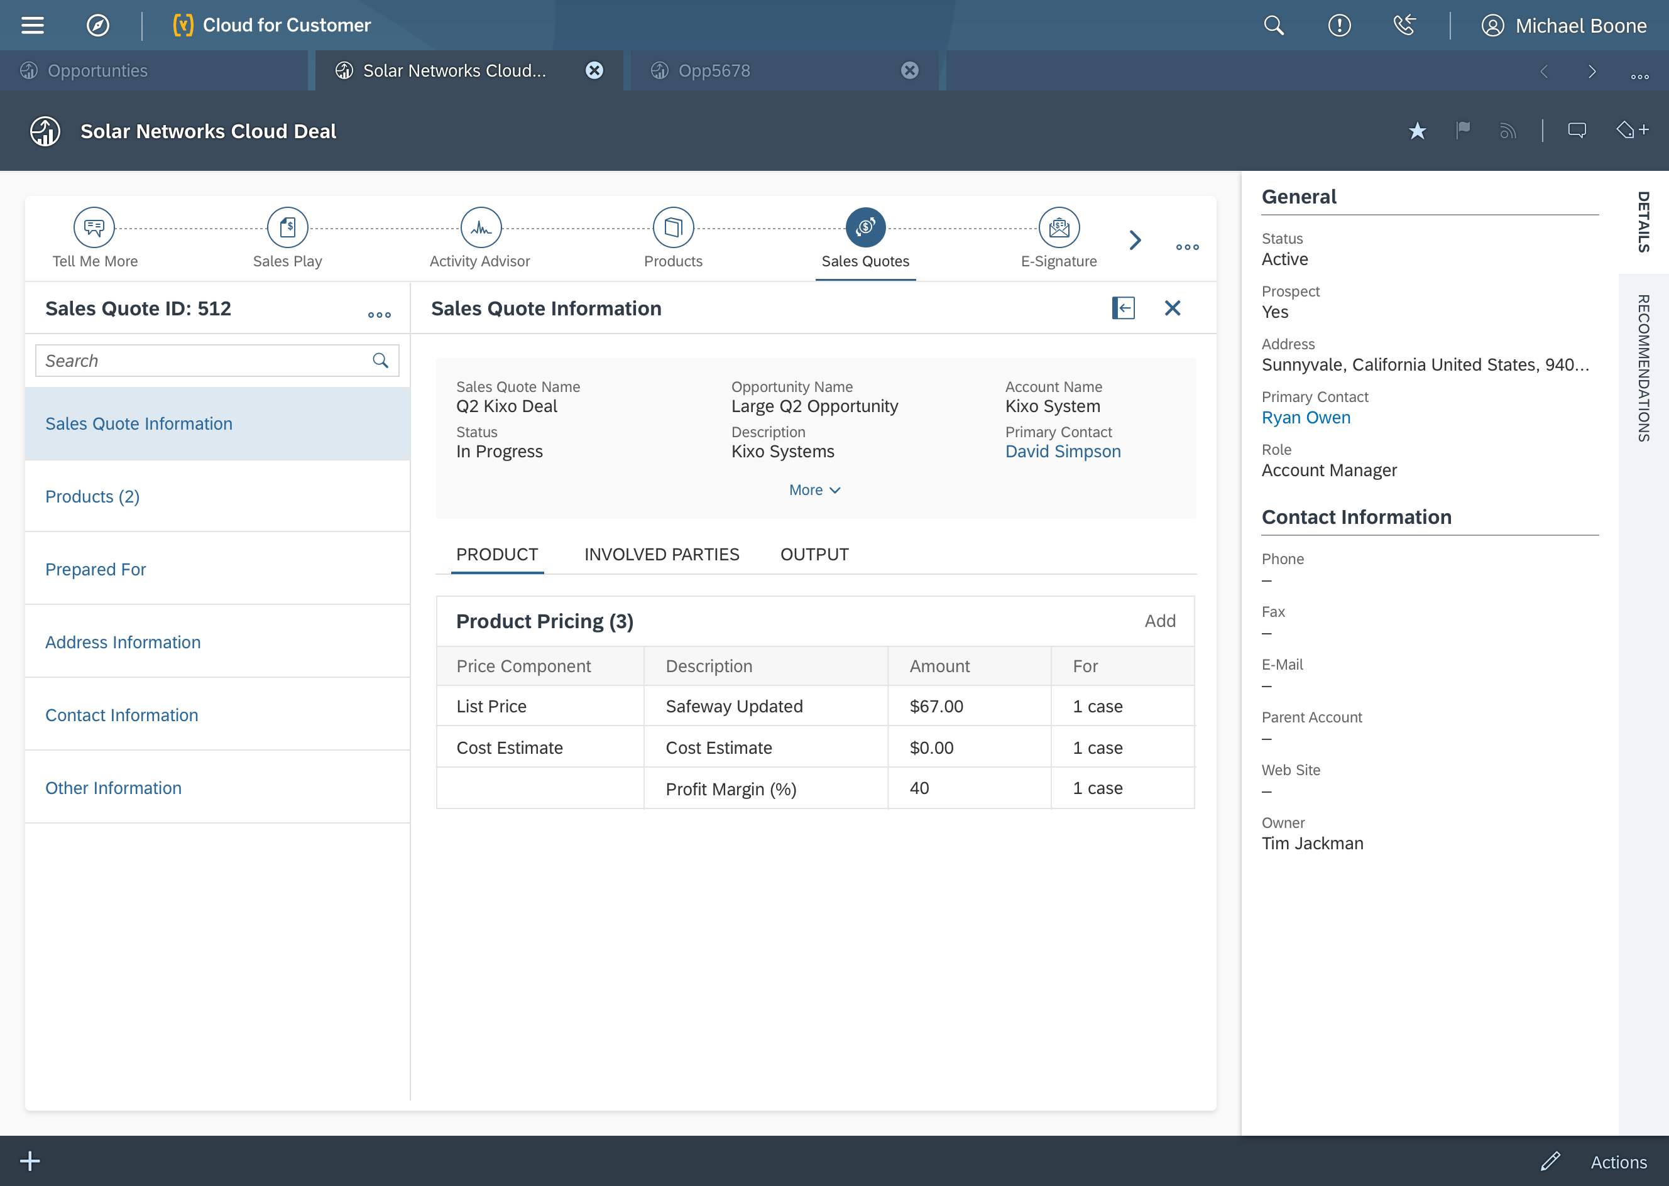
Sales Quote Object
In Guided Selling

Desktop

Slide 8
THANK YOU

